Slide 1

Writing Shaders
YOU can do it!
Unite Boston 2015
Notes:
Hello everyone. Thank you for coming and let's get started.

Slide 2


WRITING SHADERS
YOU CAN DO IT!
Yılmaz Kıymaz
Unity developer for 7 years
Shader enthusiast
Software Development Engineer at Nordeus
Notes:
My name is Yilmaz Kiymaz. I've been a Unity developer for about 7 years now

Slide 3



WRITING SHADERS
YOU CAN DO IT!
NORDEUS
Belgrade based
Developer of Top Eleven
Notes:
Nordeus is a kickass mobile games company based in Belgrade, with other offices around the world in London, Dublin, Skopje and San Francisco.
Nordeus is the developer of Top Eleven, which is the most popular and most played online football management game. We are also working very hard on new titles. And in the process, you can see from the pictures that we have a lot of fun!

Slide 4
WRITING SHADERS
YOU CAN DO IT!
Shaders are
interesting
scary!
Weird terminology
Unfamiliar math and data
Runs on the GPU!?
Primitive assembly
Rasterization
ZWrite
Cull
Stencil
Vertices, fragments
Vectors, matrices, textures
Cross product
Dot product
Matrix multiplication
Massively parallelized
Different performance criteria
Different constraints
Notes:
I remember, back when I started learning about shaders a few years ago, I thought they were super interesting. After all, they give you complete control over how your game is going to look. So I started reading online tutorials and I realized that shaders, are scary. They have all this weird terminology such as Primitive Assembly, Rasterization, ZWrites, Culling, and Stencil, none of which I knew what it meant. And they have unfamiliar math and data. They're operating on vertices and fragment, vectors and matrices and textures and they have math I was scared of even before I knew about shaders, such as cross product, dot product, matrix multiplication and more. And then someone tells me these shaders run on the GPU? Which they say is massively parallelized and has different performance criteria and constraints?

Slide 5
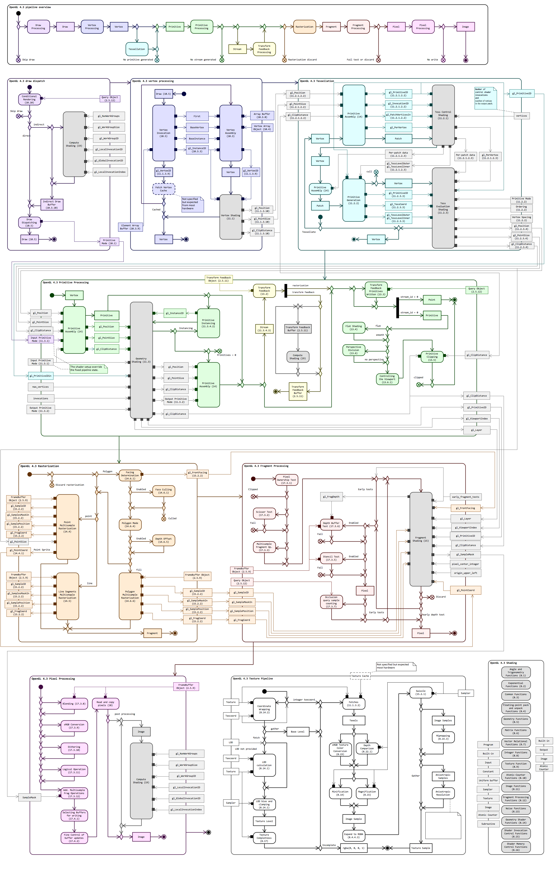
Run away?
Learn all of it?
Actually...
You don't need to worry about this
Notes:
And then I saw this. What the hell is that? I'll tell you what it is, it's the of the OpenGL 4.3 pipeline map. And that's not even all of it, that's like half. I was ready to run for my life. But then I said OK, I got this. You can do this Yilmaz. So I sat down and started reading. A lot. And stuff still didn't make much sense. Why couldn't they do things like we do in regular programming? It wasn't until I actually started getting my hands dirty that some things began to click in my mind. I started experimenting with the shaders that come with Unity, commenting out lines to see what they did, adding a few lines myself here and there, obviously creating a lot of non-compilable shaders, but this is when things actually started making sense because I could see what each part was doing. Now the online tutorials started making sense as well and soon enough I was able to write some very humble shaders from scratch.

Slide 6
WRITING SHADERS
YOU CAN DO IT!
Experiment
Fail
Learn
Repeat
Attend this talk
Learn
Profit!
Notes:
So I went through this process of experimenting, failing, then learning a few things from my failures and then repeating the whole thing again and again, quite a lot of times before I was able to actually do anything interesting. What I would like to do for you today is to spare you from this horrible near-infinite loop. Instead, you can hopefully do this. Attend this talk (which you're already doing so right on!), learn, and profit! and write your own shaders. It is pretty ambitious, so let's dive in.

Slide 7
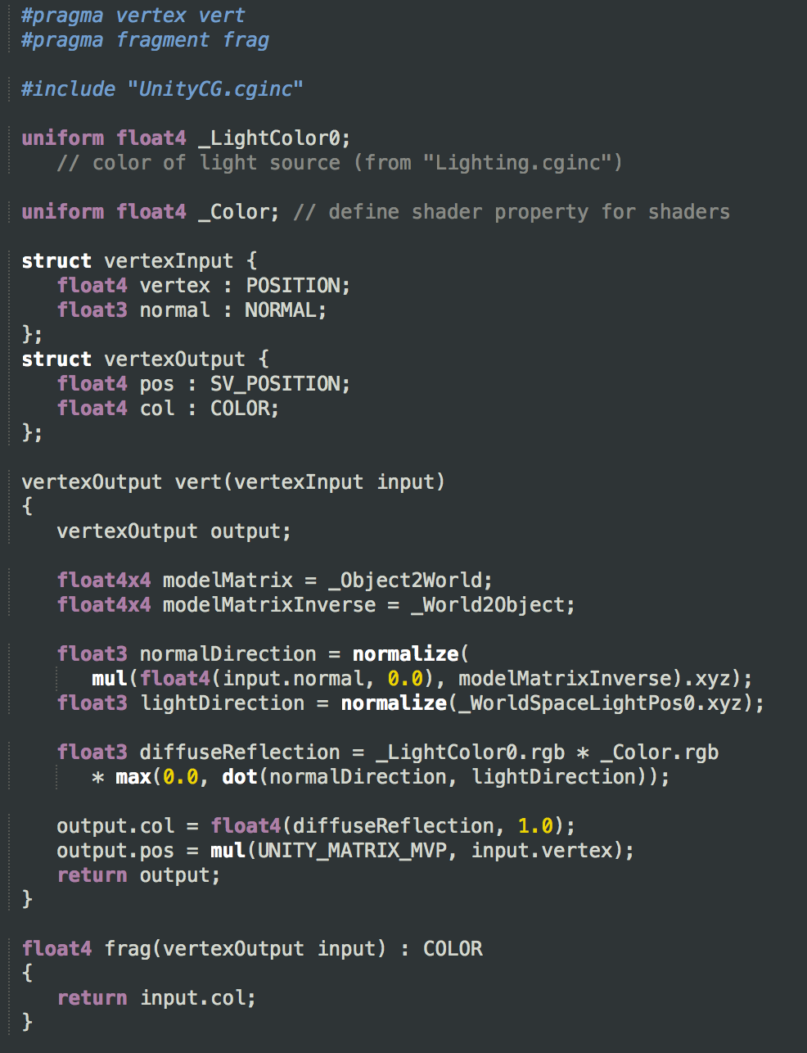
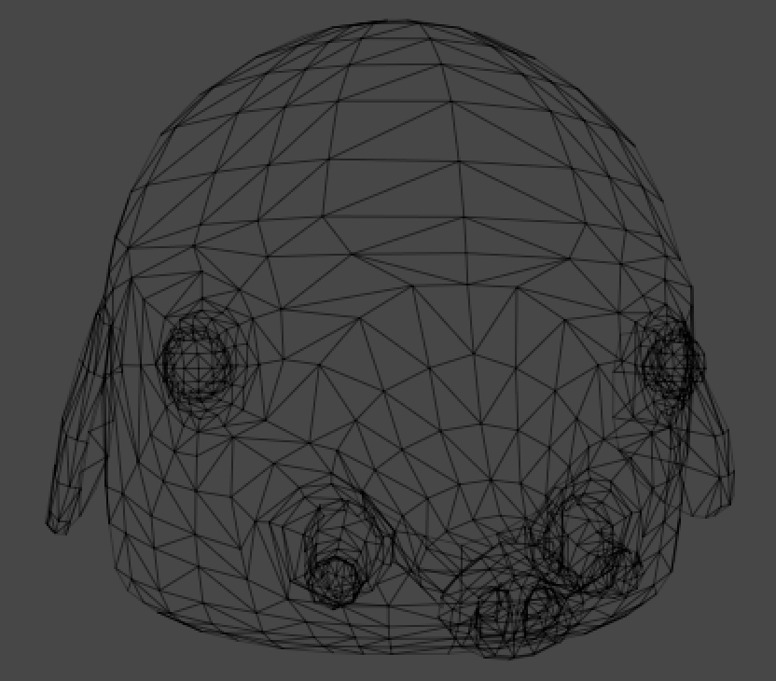
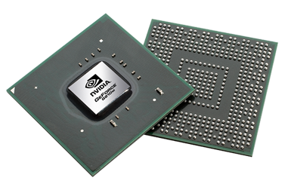
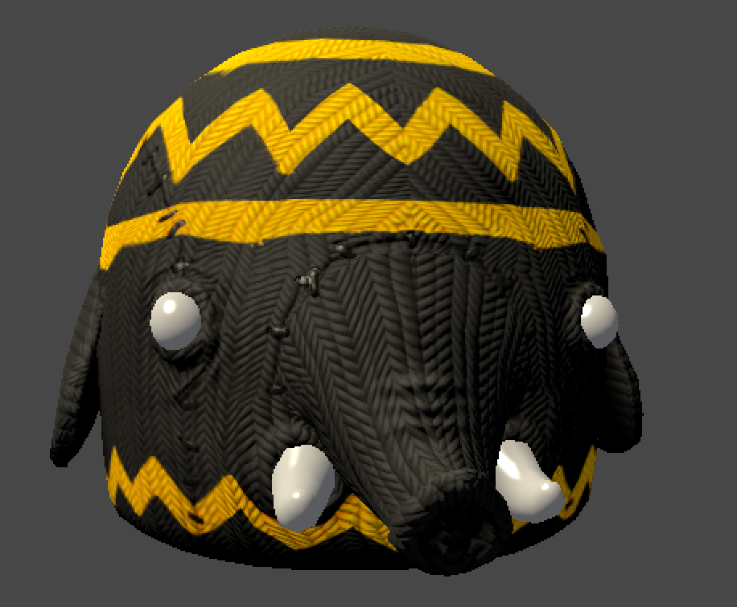
WRITING SHADERS
YOU CAN DO IT!
What are shaders?
Input
Shader
GPU
Image
Mesh
Material Data
Lighting Data
and more
Notes:
What are shaders? I thought a lot about how to give the shortest definition possible and I think it's this.
Shaders are short programs, executed on the GPU, to produce images on the screen.
That sounds nice and simple. But of course, there's a lot more going on behind the scenes. For example, there's a bunch of Input data that needs to be fed into the shader, most importantly the 3d mesh, and then material data, lighting data, and some more. These inputs are processed in the vertex and fragment programs in the shader. The GPU has specialized computation units (usually called Shader Units) to run these vertex and fragment programs and calculate the resulting pixels we see on the screen.

Slide 8
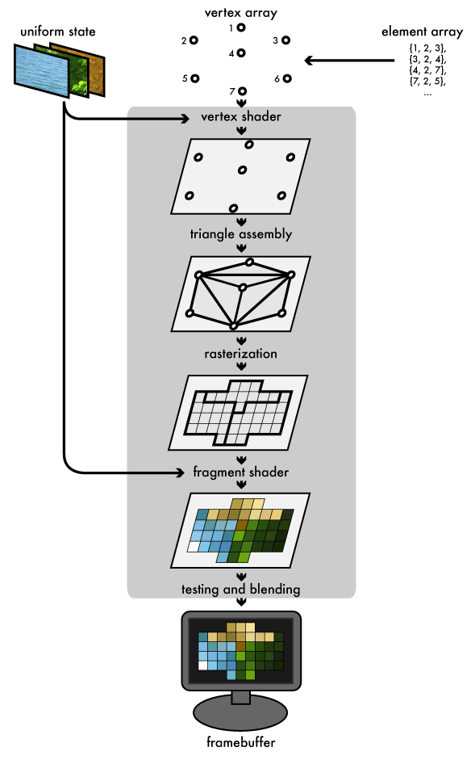
WRITING SHADERS
YOU CAN DO IT!
How do they work?
Notes:
Let's take a look at it from the GPU's point of view. When a game engine sends the 3D mesh to the GPU to be drawn, the GPU sees a bunch of vertices; a vertex array. Then the vertex shader that you and I write, processes these vertices and transforms their positions so they can be used to display the 3d mesh in the right position on the screen. Then the GPU steps in and assembles triangles from these vertices and then comes rasterization. Rasterization is the process of converting these triangles into shadable fragments. Now these aren't the same as pixels. Pixels are the final color values that end up on the screen. Fragments can actually be even smaller than pixels and some of them might get discarded based on a bunch of different criteria. But anyways, once the fragments are generated by rasterization, our own fragment shader will be run for all these fragments, to give them a Color value. And after that, based on parameters that we set up, the GPU will do testing and blending of these fragments to turn them into the final pixels that we see on the screen.

Slide 9
WRITING SHADERS
YOU CAN DO IT!
Shader Languages
HLSL
GLSL
CG
High Level Shading Language
Microsoft
DirectX
Windows, XBox
OpenGL Shading Language
OpenGL ARB (Architecture Review Board)
OpenGL
Windows, Mac, Linux, iOS, Android and more
C for Graphics
Nvidia
DirectX & OpenGL
Deprecated but...
Thanks to Unity, covers all platforms
Notes:
There are several shader languages out there to author shaders. Here are the ones that are most widespread and that you're most likely to encounter when writing shaders in Unity. There's HLSL, which is High Level Shading Language, created by Microsoft. It only works with the DirectX graphics library, which is only available on Windows and XBox. Then there's GLSL, which is OpenGL Shading Language, created by OpenGL Architecture Review Board. It only works with OpenGL which runs on many many platforms, such as Windows, Mac, Linux, iOS, Android and more. And then there's CG. It stands for C for Graphics, created by Nvidia and it supports both DirectX and OpenGL. However, it is no longer being developer however, HLSL and CG syntax is pretty much identical and when you write CG shaders in Unity, they will get cross-compiled into both GLSL and HLSL so they can run on all the platforms that Unity supports, which is great.

Slide 10
WRITING SHADERS
YOU CAN DO IT!
ShaderLab
Unity specific shading and material language
All shaders written in Unity must be wrapped with ShaderLab
May seem like extra work but it's actually saving you from a lot more work
Notes:
When writing CG shaders in Unity, it is mandatory to wrap them with Unity's own ShaderLab language. It is a Unity-specific shading and material language. It may seem like having to wrap all CG shaders in this additional language is extra work but it is actually saving you from a lot of manual work you'd have to do to manage a lot of different parameters and state and edge cases. So it's a good thing.

Slide 11
WRITING SHADERS
YOU CAN DO IT!
Dive into Unity
Notes:
Now let's switch over to Unity. First, I want to show you what I mean when I say that the vertex shader transforms the vertices of the mesh from their original positions into the final screen positions with which they are rendered.

Slide 12


WRITING SHADERS
YOU CAN DO IT!
Diffuse
Specular

Slide 13
WRITING SHADERS
YOU CAN DO IT!
RESOURCES
Unity Manual
Nvidia CG Tutorial
CG Programming in Unity wikibook
Video tutorial series on YouTube
ShaderToy
Aras' blog - aras-p.info/blog
LearnOpenGL.com
RealTimeRendering.com
Many more at
norde.us/unitewritingshaders
Notes:
There are some great resources online if you'd like to improve your knowledge on shaders. The Unity manuals ShaderLab section is a great place to start. There's a CG tutorial from Nvidia that is also pretty good at explaining a lot of concepts. The CG Programming in Unity wikibook has a lot of example shaders and good explanations. And there are at least a couple really good video tutorials on writing CG shaders in Unity. You can find links to all these resources and more at the shortened URL you see at the bottom of this slide. I'd like to show you one of these resources, which is ShaderToy, because I think it's a great website for getting inspired to write some very exotic but fun shaders.

Slide 14
WRITING SHADERS
YOU CAN DO IT!
RECAP
Shader languages
Shaders in Unity (ShaderLab)
Vertex and Fragment Programs
Lighting calculations
Resources

Slide 15
WRITING SHADERS
YOU CAN DO IT!
Q&A
yilmazk@nordeus.eu
@VoxelBoy
norde.us/unitewritingshaders

Slide 16
WRITING SHADERS
YOU CAN DO IT!
THANK YOU!

